Slide 1

The Battle of Neighborhoods – The Big Apple
New York city

Slide 2
Introduction
New York city is a compact business center, as well as one of the most popular tourist destinations in the world.
In 2018, total visitor spending was estimated to be around $44 billion.
Data published by VISA in 2016 suggested that 24% of all VISA spending was attributed to restaurants and food.
The success of a restaurant is greatly affected by its location and whether its location is close to other popular venues and destinations.
Investors and entrepreneurs can use this information to target desirable location to open a new restaurant.

Slide 3
Data acquisition and cleaning
Geographical data of New York city to explore the 5 boroughs of New York City - https://geo.nyu.edu/catalog/nyu_2451_34572
Top 100 most popular venues within 500 meters radius of each neighborhood – Foursquare API
Drop unrelated venues from the data:
Pharmacy, Gas Station, Laundromat, etc…
Separate the data into groups:
Restaurants related
Attractions (Museum, Art Gallery, Concert Hall, etc…)
Hotels
Others (Gym, Business Center, Metro Station, etc…)

Slide 4
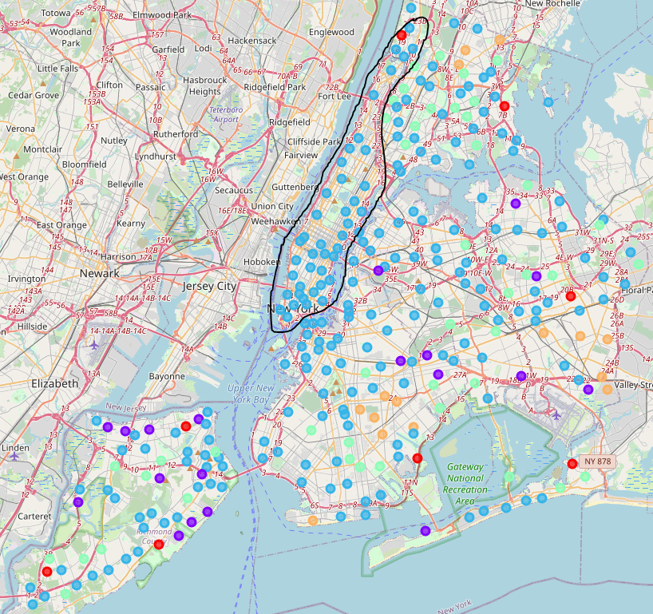
Restaurants in New York city
Extracting top 10 common restaurants in each neighborhood.
K-means clustering for 5 clusters.
Manhattan has the most condensed and populated number of restaurants out of all 5 boroughs.

Slide 5
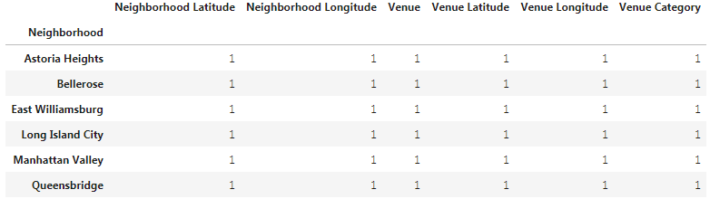
Hotels in New York city
There were not much data on hotels and lodging from our dataset.
Six hotel venues are not enough to perform our analysis.
These would be the outliers in our data, therefore should be dropped from the dataset.

Slide 6
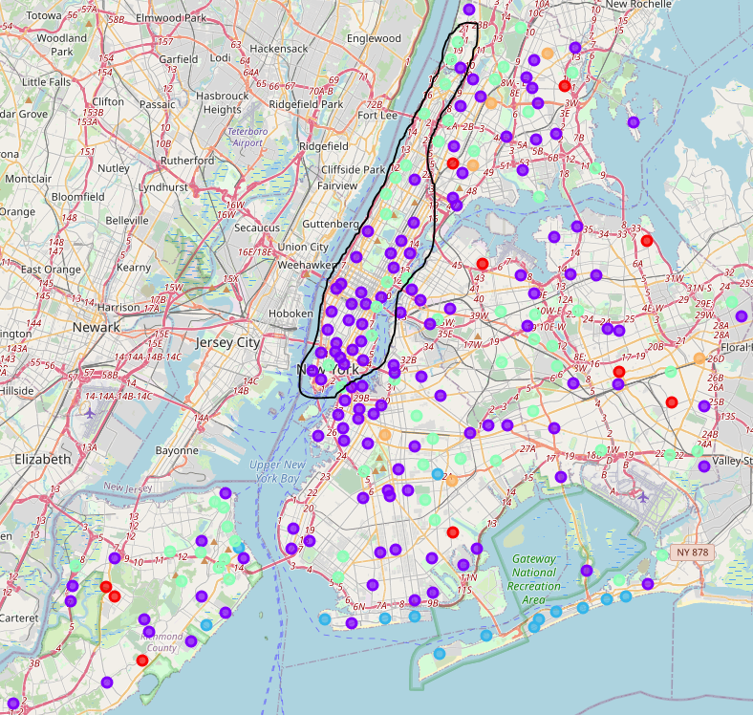
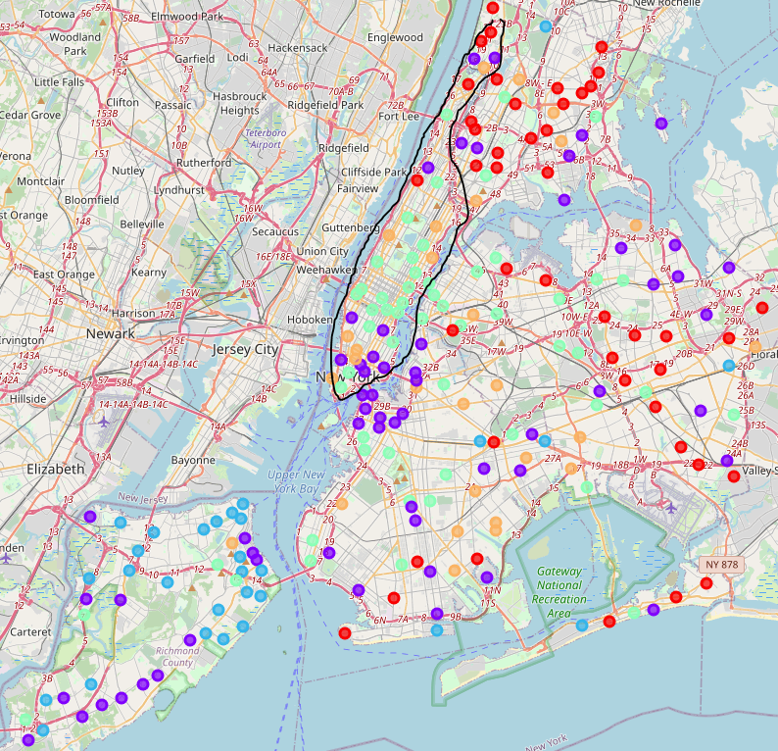
Other venues in New York city
Attractions are also densely populated in Manhattan
Other venues that attracts foot traffic

Slide 7
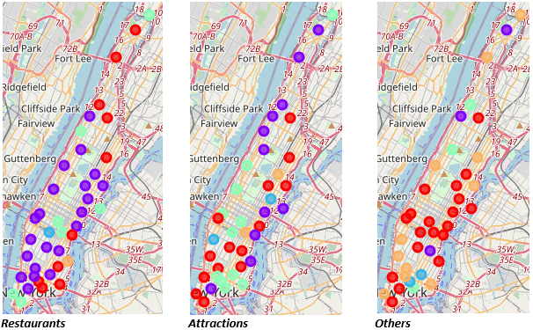
Manhattan
Isolate Manhattan from our geographical dataset.
Get the top venues for just Manhattan from Foursquare.

Slide 8
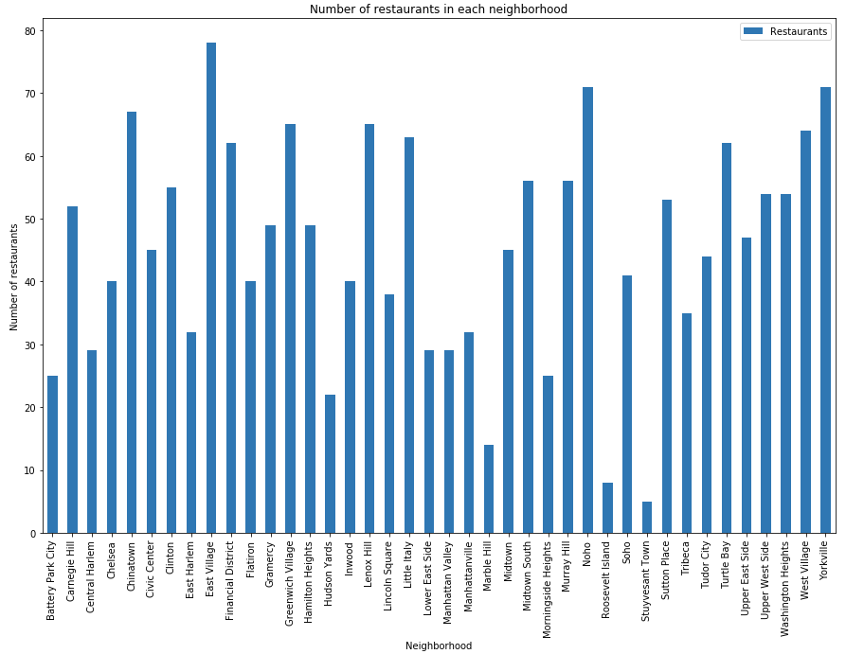
Closer look at the neighborhoods
It looks like the relevant venues are more densely populated in the south half of Manhattan.
It does not tell us which neighborhood is best.
Let us try graphing the most popular restaurants by neighborhood.
The top 4 neighborhoods are East Village, NoHo, Yorkville, and Chinatown, while Greenwich Village and Lenox Hill tie for 5th place.

Slide 9
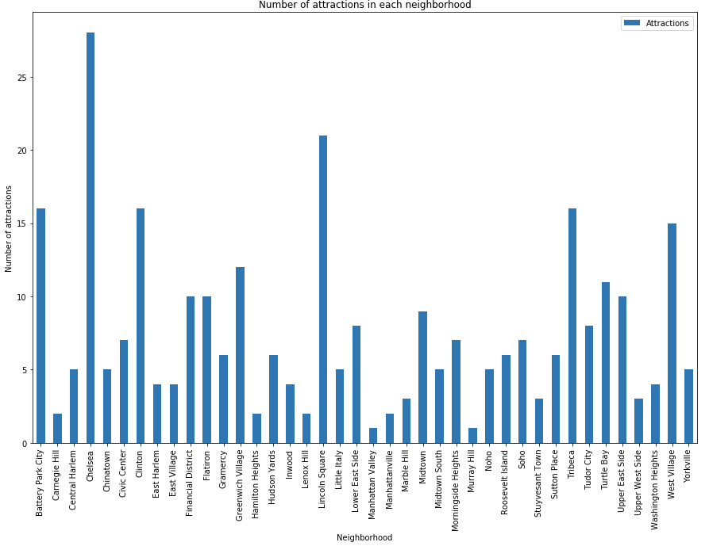
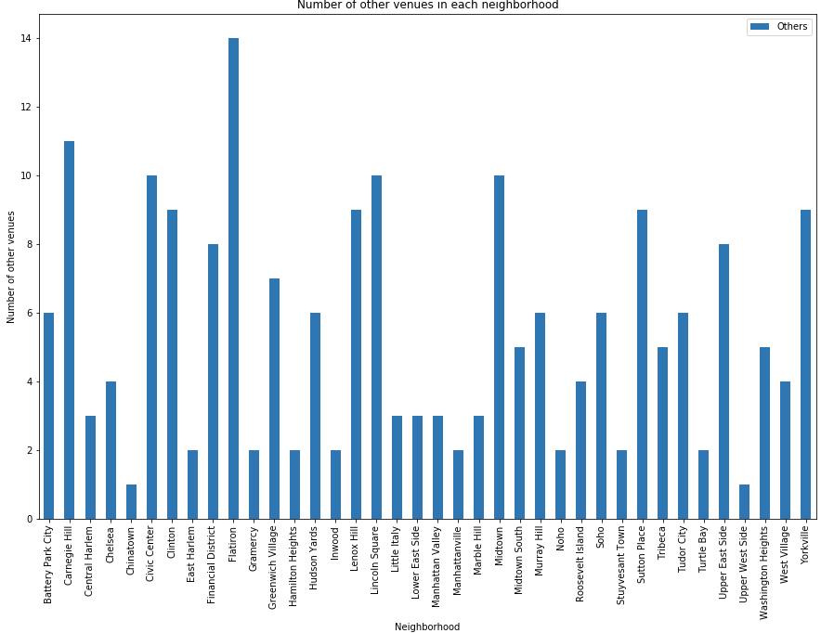
Other things to consider

Slide 10
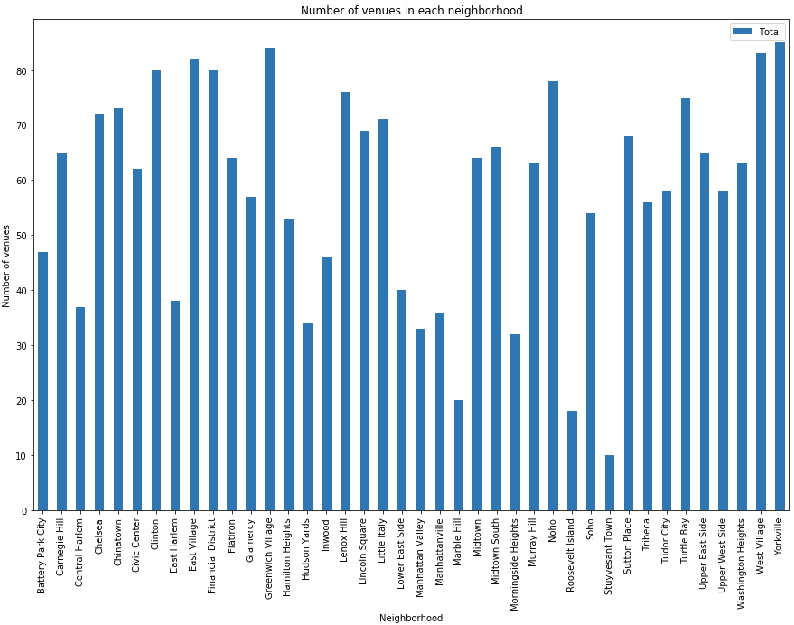
Recommendation
East Village, NoHo, Yorkville, Greenwich Village and West Village are among the top neighborhoods with the greatest number of popular restaurant venues.
They also have the most foot traffic from other venue categories.
They would be the perfect locations for a new restaurant to thrive.

